Slide 1
Self-Adaptive Multiwavelet-Based Operator
Dept.of Mathematical Sciences, KAIST
Group 2, Sungjong Lee, Jingu Hwang
June 4th, 2024

Slide 2
0. Table of contents
Table of contents
Related works
Introduction to Multiwavelet space
What is Self-Adaptive Multiwavelet-Based Operator?
Empirical evaluation
Revisiting the Spectral Bias
Summary
Appendix

Slide 3
1. Related works
Introduction
Reminder on why we study ‘Neural Operator’:
Traditional ODE/PDE solvers owes to the specific resolution during training, hence cannot be generalized to other resolutions or requires re-training
Further, some pre-knowledge on the properties of specific problem is required. For example, the equation of the model, corresponding parameters and re-calculating the custom losses.
But the Neural Operator is:
Does not depend on the discretization of the space.
Zero-shot super resolution technique is possible.
It is totally data-driven method, which can be generalized to various kinds of the problems.

Slide 4
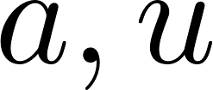
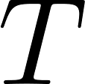
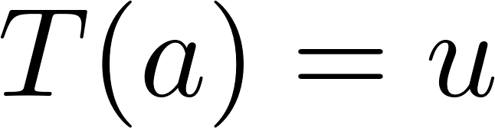
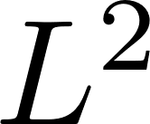
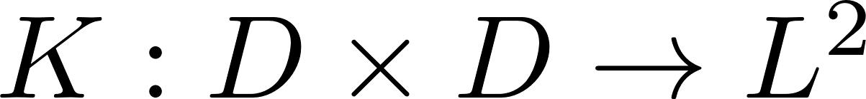
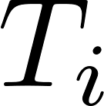

2. Introduction to Multiwavelet space
Problem setup
Given two functions the operator is the map such that , mapping the solution function space to output function space. We take norm over the space.
We design the operator to be an integral operator with kernel ,
A black-box neural operator is defined as
where each denotes canonical integral operator and denotes non-linear activation.

Slide 5
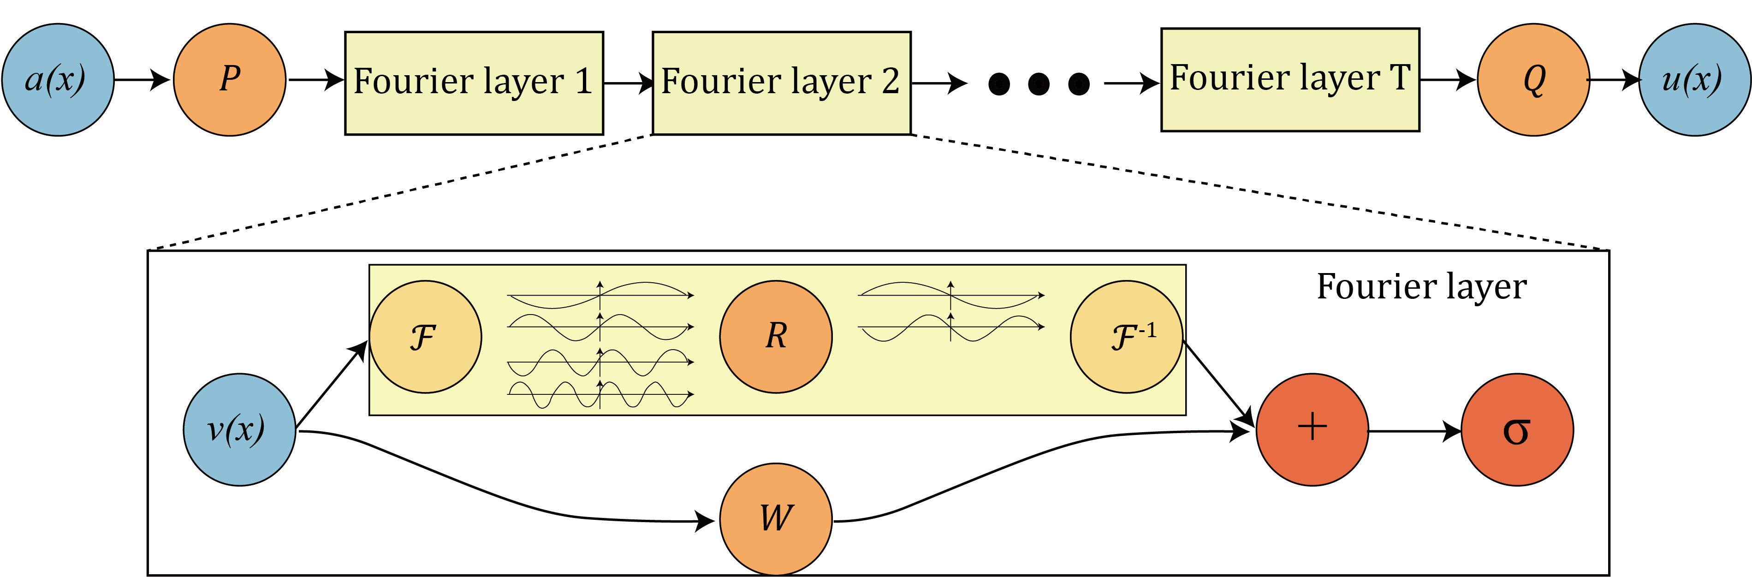
2. Introduction to Multiwavelet space
Problem setup
Fourier operator setup

Slide 6
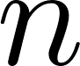
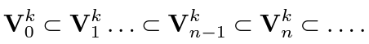
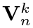
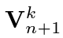
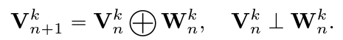
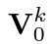
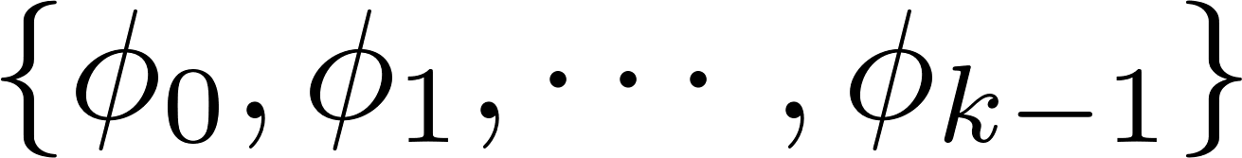
2. Introduction to Multiwavelet space
Multiwavelet Transform
Multi Resolution Analysis : We define a space of piecewise polynomial functions,
For subsequence , each subspace is contained in another by
and define the multiwavelet subspace by the orthogonal complement of over by
If the basis of is given as , we can construct the (Hilbert) basis of via scaling and translation of mother wavelet,

Slide 7
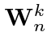
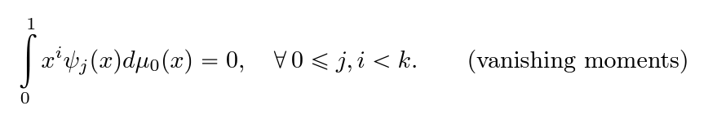

2. Introduction to Multiwavelet space
Multiwavelet Transform
Consequently, using Gram-Schmidt orthogonalization we obtain the basis of . Similarly, with appropriate shifting and scaling, we obtain the basis of .
Further, it has the property of vanishing moments:
This yields the compression of the kernel; consider the Taylor expansion of smooth function:

Slide 8
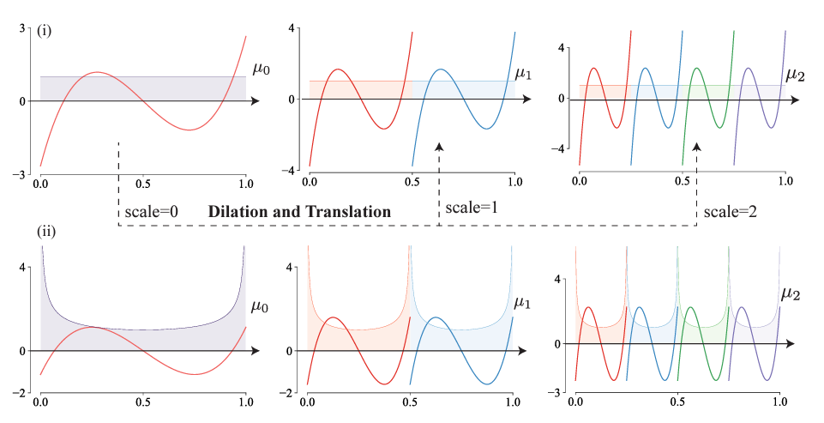
2. Introduction to Multiwavelet space
Multiwavelet Transform

Slide 9
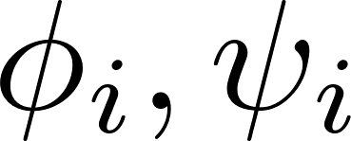
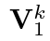
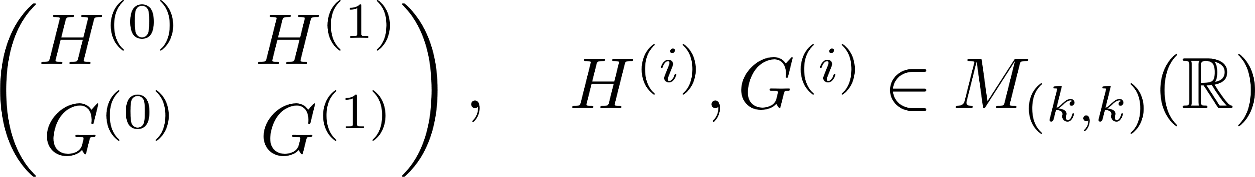
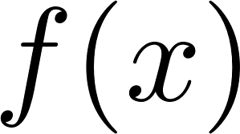
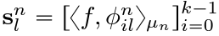
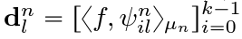
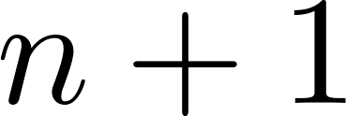
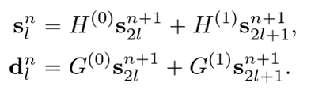
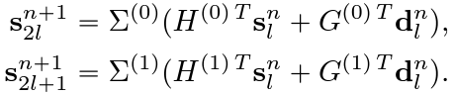
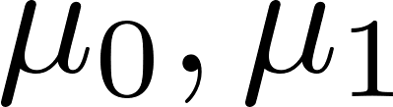
2. Introduction to Multiwavelet space
Multiwavelet Transform
Multiwavelet filters are the linear coefficients of the written as a linear combination of the basis of . We denote it as
In detail, for given the multiwavelet coefficients at scale is defined by
has the relation with the coefficients at scale given by
Correction term due to difference in measure

Slide 10
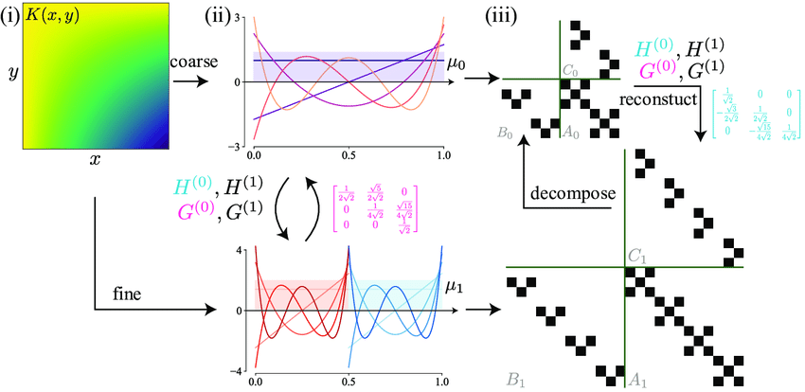
2. Introduction to Multiwavelet space
Multiwavelet Transform

Slide 11
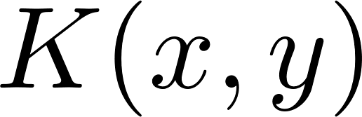
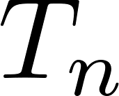
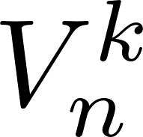
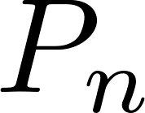
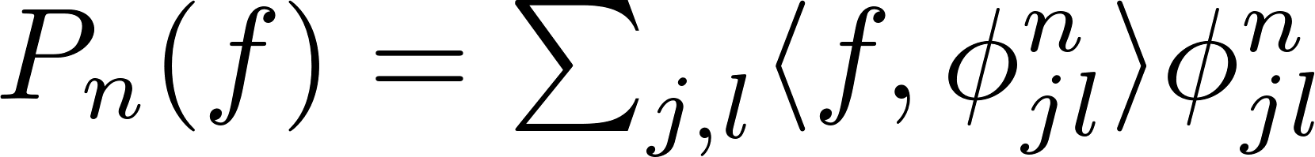
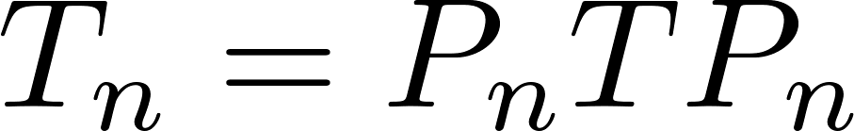
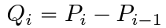
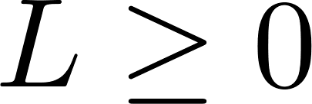
2. Introduction to Multiwavelet space
Multiwavelet Transform
Non-standard wavelet representation
Let be integral operator with kernel . Let be the projection of over . If is the projection operator defined by
then we have . Ultimately, we obtain
via telescoping sum. Here, is the coarsest scale under consideration.

Slide 12
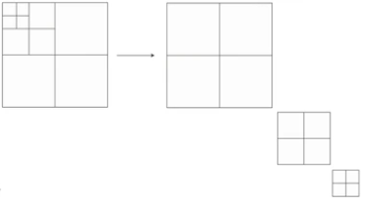
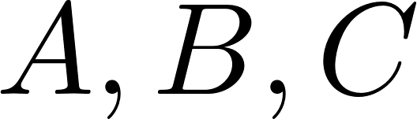
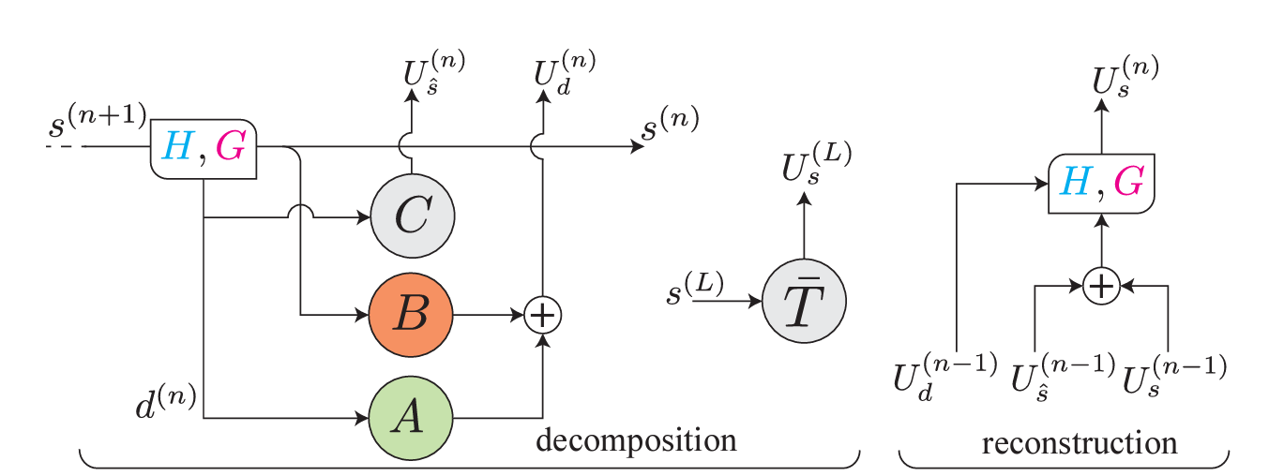
2. Introduction to Multiwavelet space
Multiwavelet Transform
Decouple scale interactions
In practice, we usually take
to be the fixed size kernel neural networks(e.g. single slide CNN).

Slide 13
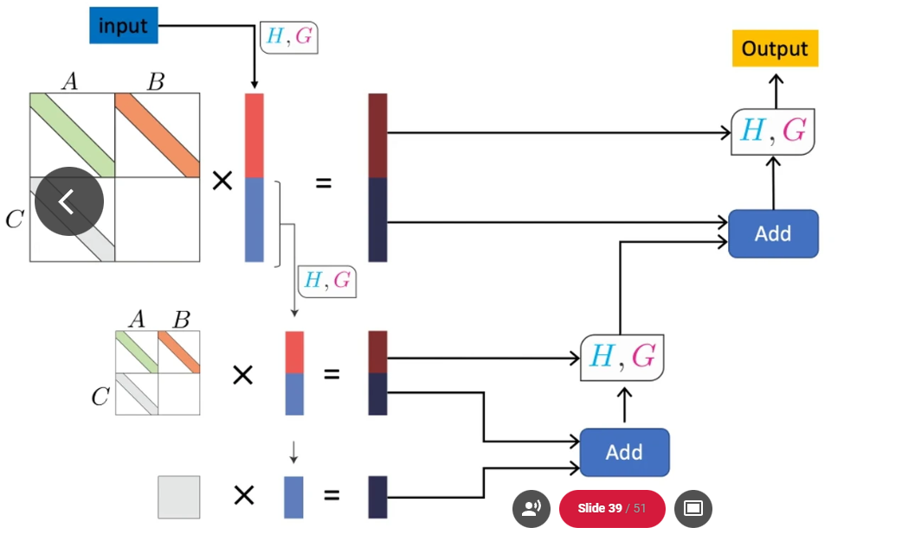
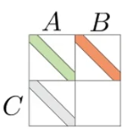
2. Introduction to Multiwavelet space
Multiwavelet Transform

Slide 14
3. Self Adaptive Multiwavelet Neural Operator
Drawbacks of MWO
Slow than FNO..
Needs further study over the frequency domain
Not many variants developed yet(unlike FNO)- hard to modify the multiwavelet representation
Our goal is…
Speed up!
Higher accuracy(if possible)
Investigate the frequencies

Slide 15
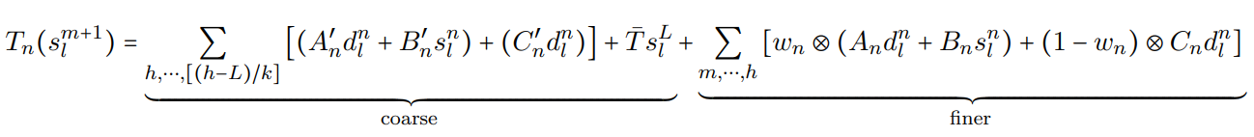
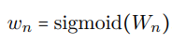
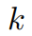
3. Self-Adaptive Multiwavelet based Operator
Self-Adaptive Multiwavelet based Operator(SA-MWO)
We now propose a novel method that can both speed up and improve the accuracy at the same time, by applying a simple trick over the non-standard wavelet representation as
Here is the weight given to the detailed coefficient(high frequency part at that scale) and and are the hyper-parameters, respectively.
This is nothing but we are training the kernel separately in different scales(coarse and finer) and truncating some of the unnecessarily coarse part.
Moreover, the most important part is that we gave self-adaptive soft weights, for the sake of forcing the model to choose between the high and low frequency parts of the provided data.

Slide 16
3. Self-Adaptive Multiwavelet based Operator
Advantages of the SA-MWO
Our proposed model SA-MWO is approximately 25~30% faster than the original MWO, in the mean of training speed.
SA-MWO showed better performances than the MWO, in the mean of relative L2 error.
For the experiment, we compared over the problems with same dataset(KDV and Burger’s equation), same optimizer and same hyperparameter setting as in the original MWO paper.
We could also empirically verify the SA-MWO’s tendency to capture various range of frequencies during the training.

Slide 17
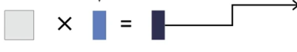

3. Self-Adaptive Multiwavelet based Operator
Architecture detail
Self learnable weights
w
1-w
w
1-w
truncate!
Original MWO structure at coarse scale

Slide 18
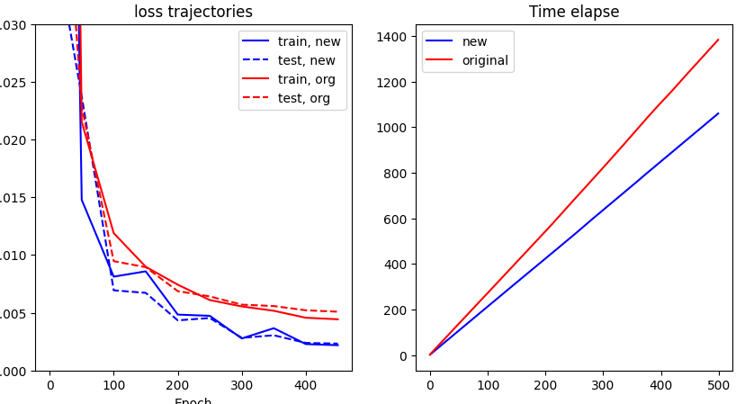
4. Empirical evaluation
Loss trajectory
KDV equation, Chebyshev filter, 500 epoch. Elapsed time: SA-MWO ~ 1050s, MWO ~ 1382s. Relative L2 error for: SA-MWO ~ 0.002, MWO ~ 0.005.

Slide 19
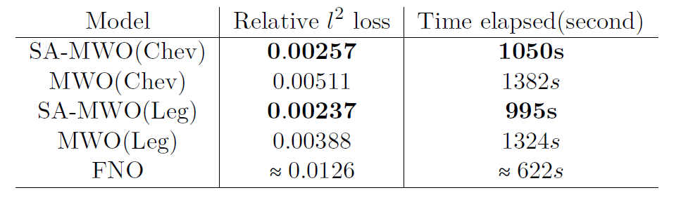
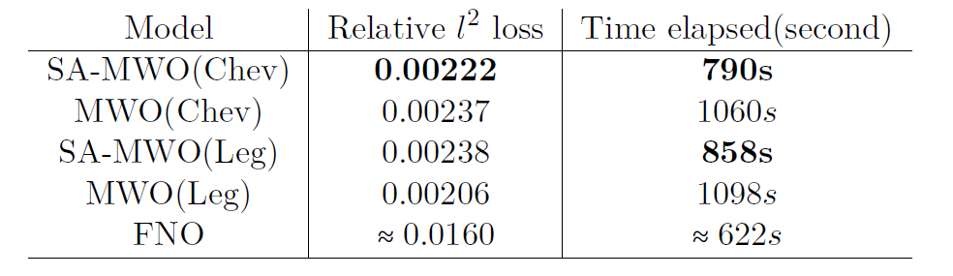
4. Empirical evaluation
Comparison study
KDV equation, 500 epoch, resolution = 1024.
Burger’s equation, 500 epoch, resolution = 1024.

Slide 20
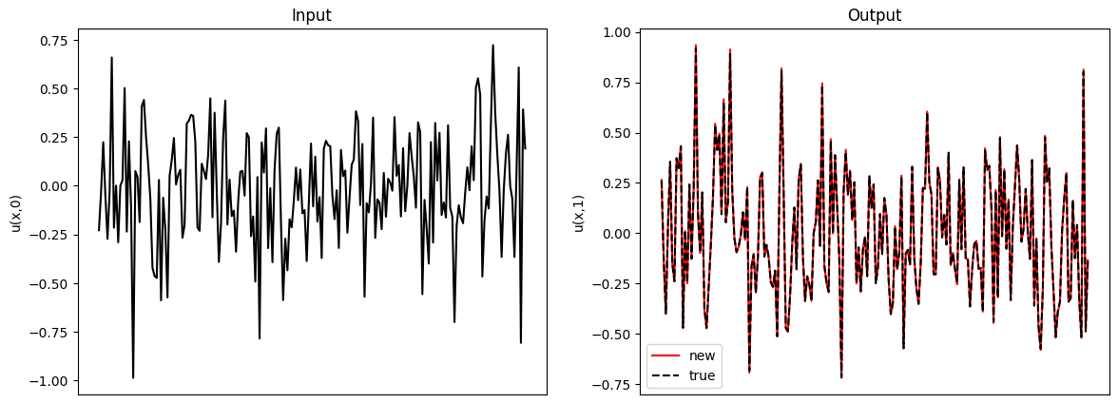
4. Empirical evaluation
Input- Output trajectory plot
KDV equation, 500 epoch, SA-MWO.

Slide 21
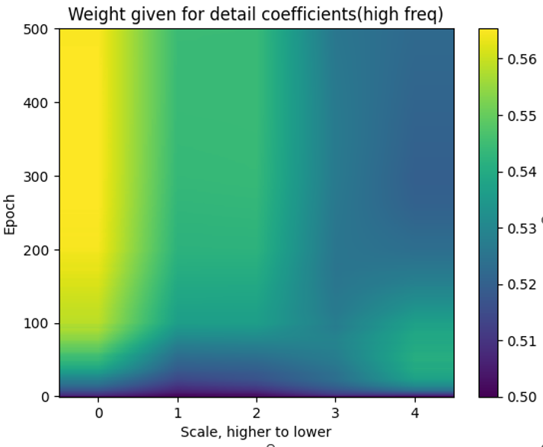

5. Revisiting Spectral Bias
Weight bias – scale/frequency interaction
Distribution of value of weights over detailed coefficients is as follows(KdV equation, left for Chebyshev and right for Legendre filter).
Has tendency to give relatively more weights to high frequency at the higher scale, while a bit less at the lower scale.

Slide 22


5. Revisiting Spectral Bias
Analysis over frequency domain- Revisiting the spectral bias
Even under the heavy influence of spectral bias, both MWO and SA-MWO tries to learn at the multi-frequency.
One of the notable thing is that in SA-MWO, in the early state of training there exists consistent shift between the frequencies to self-adapt the range of frequency for itself to learn(KdV equation).
This can be one of the empirical evidence of our proposed model’s ability to adaptively choose the domain of frequency(to be learnt).

Slide 23


5. Revisiting Spectral Bias
Analysis over frequency domain- Revisiting the spectral bias
However, as the number of training gets larger, SA-MWO captures broader multi-frequency range during the training earlier than the MWO.
Epoch, 100~
Epoch, 400~500

Slide 24

5. Revisiting Spectral Bias
Analysis over frequency domain- Revisiting the spectral bias
In the broader range of frequency(5~500hz), we can investigate this fact further:

Slide 25


5. Revisiting Spectral Bias
Analysis over frequency domain- Revisiting the spectral bias
For Burger’s equation(Chebyshev filter), where we obtained the lowest l2 error rate, we found that the model behaved almost same as in the case of Kdv equation.
Full epoch
Epoch, 400~

Slide 26
6. Summary
Further comments
MWO is the model that learns the kernel by the multiwavelet transform, just like the case of FNO.
Our proposed model SA-MWO uses a soft kind of attention mechanism for the model itself to adaptively choose the frequency where it prefers to learn during the training.
Further by truncating the unnecessary coarse scale features, we get much lighter version of MWO(at least 25% faster).
SA-MWO is much faster and almost accurate or better(2x) than the original MWO, in both the cases of KDV equation and Burger’s equation.

Slide 27
6. Summary
Limitations and future works
Although SA-MWO has good performance, it does not rely much on the existing rigorous theory.
For example, we do not have satisfactory interpretation over the weight distribution of the model.
Moreover, the both MWO and SA-MWO tries to learn the data at the multiple frequencies, but not very much deviating from the dominance of the spectral bias. Also, there is no consistent visible patterns to retract SA-MWO’s preference over certain frequencies.
Still there are also other methods to improve the original MWO, for example: choice of different matrix filters, novel structure to implement the wavelet representation along with fast-discrete multiwavelet transform(instead of non-standard wavelet representation). Indeed, in most of the cases, model with the Legendre filter was much faster and accurate than the one using Chebyshev filter.
Needs further verifications via training over various PDE dataset.

Slide 28










7. Appendix
Multiwavelet Transform- Decomposition
Computation methods- Decomposition
: Radon-Nikodym derivative

Slide 29









7. Appendix
Multiwavelet Transform-Reconstruction
Computation methods – Reconstruction
: followed from the orthonormality of bases

Slide 30








7. Appendix
Matrix filter, examples
Some of the examples: Legendre polynomials, 3 bases
The weight function can be approximate by Gaussian-Quadrature;
Recurrence formula is solved for Legendre case,

Slide 31



7. Appendix
Matrix filter, examples
Some of the examples: Chebyshev polynomials, 3 bases

